Slide 1
Contents
Alkali Metals
Electrostructure and reactivity
Physical properties
Reactions
Uses
Summary activities

Slide 2
Group 1 – the alkali metals
Alkali metals are in group 1 of the periodic table, on the left.
1
Of these alkali metals, francium (Fr) is a very rare, radioactive and unstable element. This makes it difficult to study.
H
He
Li
Li
Be
B
C
N
O
F
Ne
Na
Na
Mg
Al
Si
P
S
Cl
Ar
K
K
Ca
Sc
Ti
V
Cr
Mn
Fe
Co
Ni
Cu
Zn
Ga
Ge
As
Se
Br
Kr
Rb
Rb
Sr
Y
Zr
Nb
Mo
Tc
Ru
Rh
Pd
Ag
Cd
In
Sn
Sb
Te
I
Xe
Cs
Cs
Ba
La
Hf
Ta
W
Re
Os
Ir
Pt
Au
Hg
Tl
Pb
Bi
Po
At
Rn
Fr
Fr
Ra
Ac
Rf
Db
Sg
Bh
Hs
Mt
Ds
Rg
?
?
?
?
?
?
?

Slide 3
Electron structure
All alkali metals have 1 electron in their outer shell.
This means that:
lithium
2,1
They can easily obtain a full outer shell by losing 1 electron.
sodium
2,8,1
They all lose their outer shell electron in reactions to form positive ions with a +1 charge.
They have similar physical and chemical properties.
potassium
2,8,8,1

Slide 4
Electron structure and reactivity
The reactivity of alkali metals increases down the group. What is the reason for this?
The size of each element’s atoms, and the number of full electron shells, increases down the group.
Li
Na
This means that, down the group, the electron in the outer shell gets further away from the nucleus and is shielded by more electron shells.
K
increase in reactivity
Rb
The further an electron is from the positive attraction of the nucleus, the easier it can be lost in reactions.
Cs
This means that reactivity increases as the size of the atom increases.

Slide 5
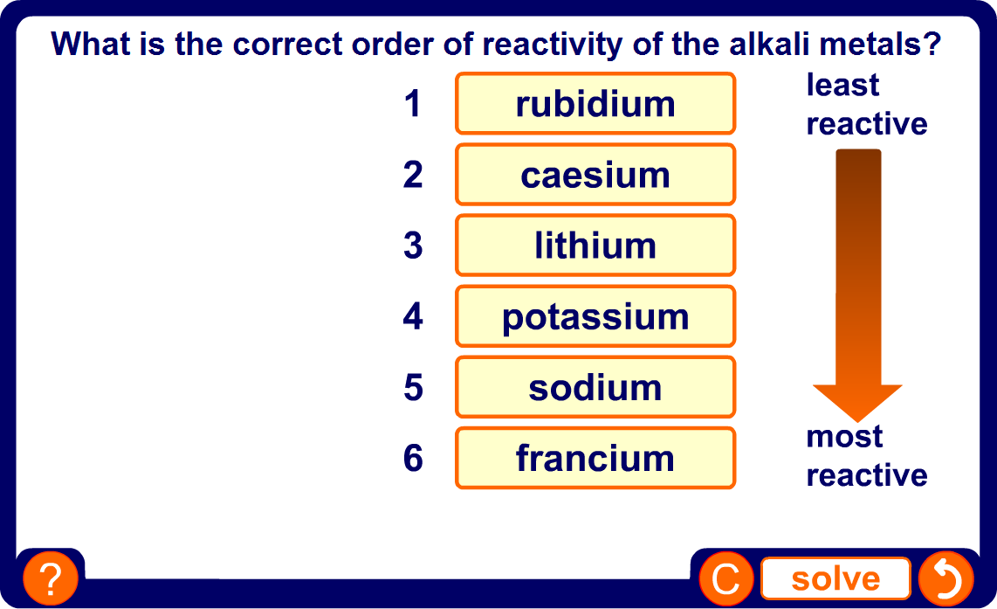
Reactivity of the alkali metals

Slide 6
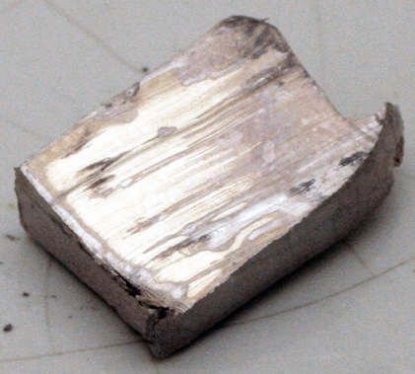
General properties
Alkali metals are different to typical (transition) metals, such as iron and copper. Unlike typical metals, alkali metals:
are soft and can be cut by a knife – softness increases down the group;
have a low density – lithium, sodium and potassium float on water;
have low melting and boiling points.
However, alkali metals do share a few properties with typical metals, because:
they are good conductors of heat and electricity;
they are shiny – this is only seen when they are freshly cut.

Slide 7
Trends in density
The alkali metals generally become more dense down the group, but the trend is not perfect because potassium is less dense than sodium.
Element
Density (g/dm³)
lithium
0.53
sodium
0.97
potassium
0.86
rubidium
1.53
caesium
1.87
Water has a density of 1 g/dm³. Lithium, sodium and potassium are all less dense than water and so will float.

Slide 8
Trends in melting point
The melting point of alkali metals decreases down the group.
Element
Melting point (°C)
lithium
181
sodium
98
potassium
64
rubidium
39
caesium
28
Melting points are lower than for typical (transition) metals, because alkali metals only have 1 electron in their outer shell. Not much energy is needed for this electron to be lost.

Slide 9
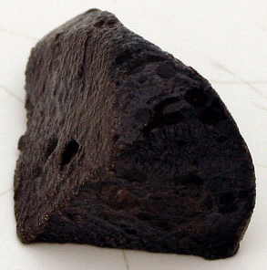
Reactions with air
All alkali metals react with air to form metal oxides. This produces a layer of dull oxide on the surface of the metal, called tarnish.
The speed with which alkali metals react with air increases down the group:
lithium – tarnishes slowly;
sodium – tarnishes quickly;
potassium – tarnishes very quickly.
Why are alkali metals stored in oil?
The oil prevents them from reacting with air and tarnishing.

Slide 10
Equations for reaction with air
The reaction between an alkali metal and air is an example of an oxidation reaction:
lithium + oxygen ➔ lithium oxide
4Li (s) + O₂ (g) ➔ 2Li₂O (s)
What are the word and chemical equations for the reaction of sodium and air?
sodium + oxygen ➔ sodium oxide
4Na (s) + O₂ (g) ➔ 2Na₂O (s)

Slide 11



Flame colour
When alkali metals are heated and added to a jar of oxygen, they burn fiercely with a coloured flame.
lithium burns with a red flame
sodium burns with an orange flame
potassium burns with a lilac flame

Slide 12
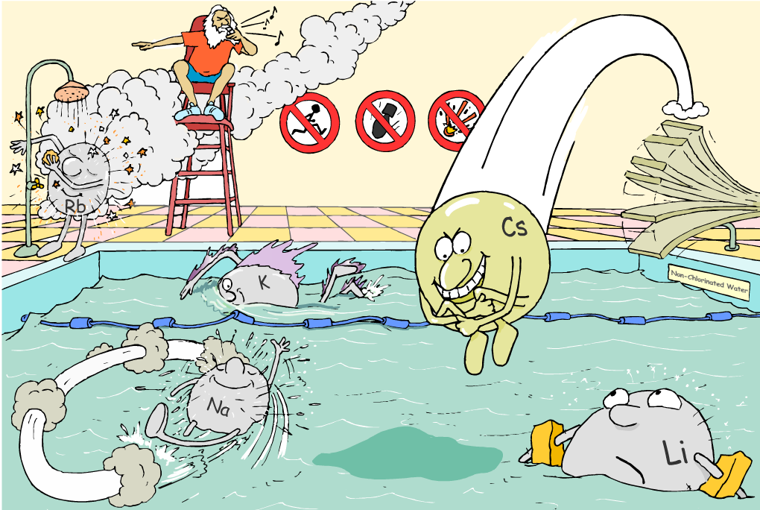
Alkali metals and water
How do alkali metals react with water?

Slide 13
Reactions with water
All alkali metals react readily with water. The reaction becomes more vigorous down the group, and creates a lot of heat.
H
H
+
-
O
Li
O
H
Li
Li
+
+
+
H
H
+
-
H
H
Li
O
H
O
This reaction creates alkaline hydroxide ions. This is why the group 1 elements are called the alkali metals.
The reaction also produces a gas that can be ignited by a lighted splint. What is this gas?

Slide 14
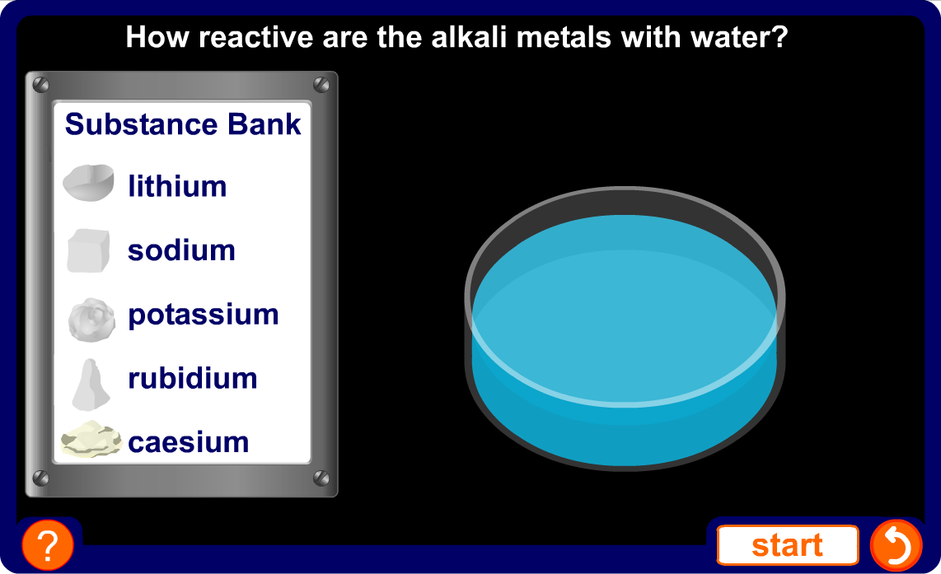
Reactivity of alkali metals with water

Slide 15
Reaction of lithium with water
Lithium is the least reactive of the alkali metals. When added to water, it fizzes and moves around slowly across the surface of the water.
lithium + water ➔ lithium + hydrogen hydroxide
2Li (s) + 2H₂O (l) ➔ 2LiOH (aq) + H₂ (g)

Slide 16
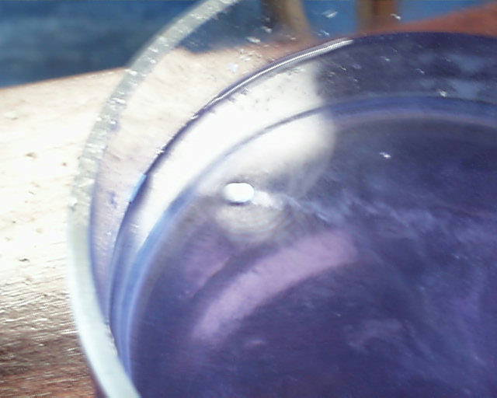
Reaction of sodium with water
When added to water, sodium fizzes more than lithium, and moves quickly across the surface of the water. The sodium melts as it reacts, and it becomes spherical and shiny, like a ball bearing. The hydrogen sometimes catches fire because of the heat from the reaction.
What is the equation for this reaction?
sodium + water ➔ sodium + hydrogen hydroxide
2Na (s) + 2H₂O (l) ➔ 2NaOH (aq) + H₂ (g)

Slide 17
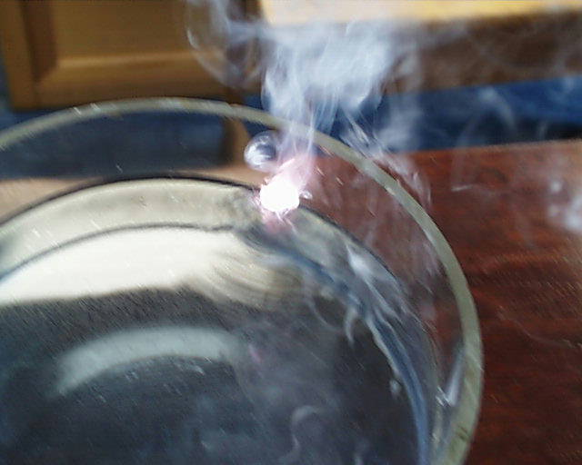
Reaction of potassium with water
When added to water, potassium burns with a lilac flame and the hydrogen catches fire immediately. The potassium moves across the surface of the water very quickly. Like sodium, it melts with the heat of the reaction.
What is the equation for this reaction?
potassium + water ➔ potassium + hydrogen hydroxide
2K (s) + 2H₂O (l) ➔ 2KOH (aq) + H₂ (g)

Slide 18
Reaction of alkali metals and chlorine
Alkali metals burst into flame when heated and added to chlorine. They form metal chlorides:
lithium + chlorine ➔ lithium chloride
2Li (s) + Cl₂ (g) ➔ 2LiCl (s)
What are the word and chemical equations for the reaction of sodium and chlorine?
sodium + chlorine ➔ sodium chloride
2Na (s) + Cl₂ (g) ➔ 2NaCl (s)

Slide 19
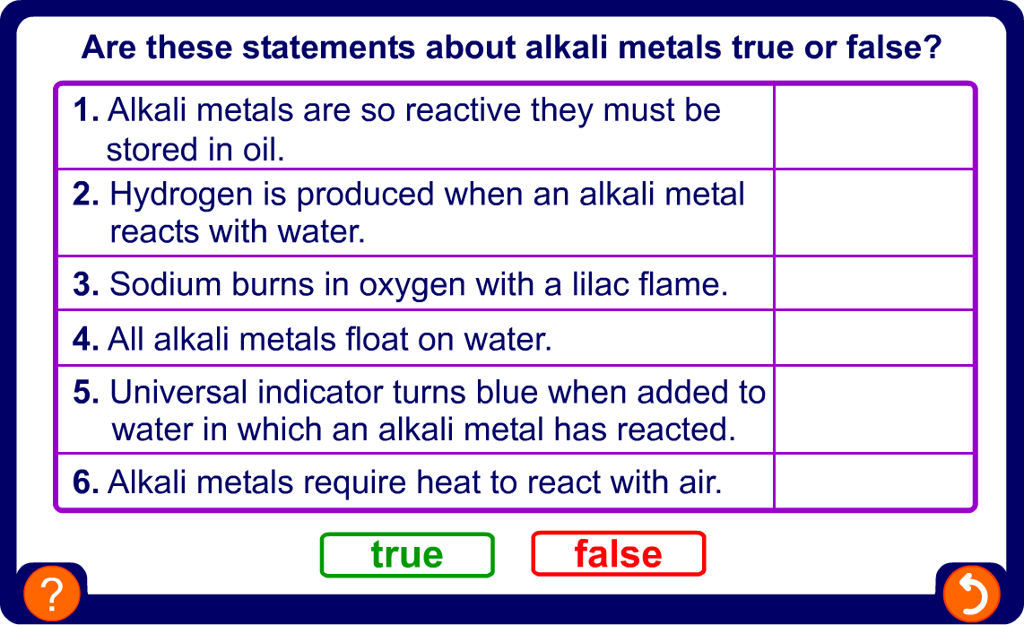
True or false?

Slide 20
Uses of lithium
Lithium and its compounds are used in:
batteries – elemental lithium is used in non-rechargeable batteries. Lithium compounds are used in lithium-ion batteries, which are rechargeable.
alloys – with other metals, such as aluminium, copper and manganese, for use in aircraft parts.
medical treatment – lithium carbonate is sometimes used to treat mental illnesses such as depression.
submarines and space vehicles – lithium hydroxide is used to absorb carbon dioxide from the air.

Slide 21

Uses of sodium
Elemental sodium is used in:
street lights – sodium vapour gives them their yellow glow.
nuclear reactors – used as a coolant due to its good conductivity and low melting point.
Sodium compounds are in many household products:
sodium chloride – table salt
sodium hydrogencarbonate – bicarbonate of soda
sodium hydroxide – oven cleaner

Slide 22
Uses of potassium
Potassium compounds are used in:
fertilizers – potassium is an essential element for plants. It is usually added as a chloride, sulfate, nitrate or carbonate.
fireworks and explosives – as potassium nitrate and potassium chlorate.
food preservation – as potassium nitrate.

Slide 23
Glossary
alkali metal – An element that belongs to group 1 of the periodic table.
hydroxide – The alkali produced by the reaction between an alkali metal and water. It is a compound ion with a charge of -1.
metal chloride – The solid produced when an alkali metal is burned in chlorine gas.
metal oxide – The solid produced when an alkali metal reacts with air.
oxidation – The process by which a substance reacts with oxygen to produce an oxide.
tarnish – Discolouration of metal after exposure to air caused by the formation of an oxide on the surface.

Slide 24
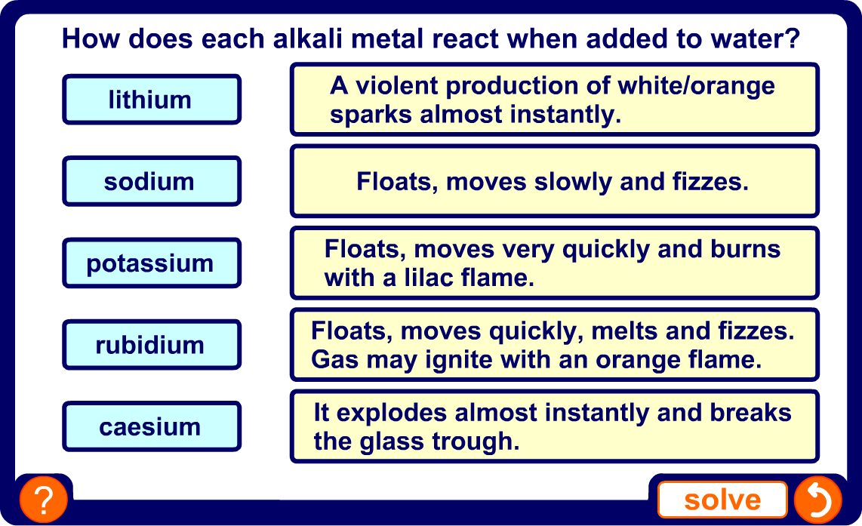
Comparing reactivity with water

